Slide 1
ICA-AP & Cooperative Union of Kyrgyzstan Forum on “Development of Co-operatives in Central Asia” Consumer Co-operative Business Development in Japan
Haruyoshi Amano
Japanese Consumers’ Co-operative Union (JCCU)

Slide 2
Contents
Outline of consumer co-op in Japan
Community based co-ops
Contribution to local communities
History of consumer co-op movement in Japan
Notes:
There are many types of consumers' cooperative in the world. They are grocer, health care, welfare, insurance, and housing cooperatives as well as credit unions, utility and multipurpose cooperatives.
In Japan there are several co-operative acts that rule different sectors of cooperatives such as agriculture, fisheries, forestry, finance, etc..
Consumers' cooperatives are set up based on the Consumer Cooperatives Act and the cooperatives set up by the act are categorized as consumer cooperative.
The main purpose of consumers' co-ops is to provide quality goods and services at the low cost to the consumers/owners.
In practice consumer co-ops price goods and services at competitive market rates.

Slide 3
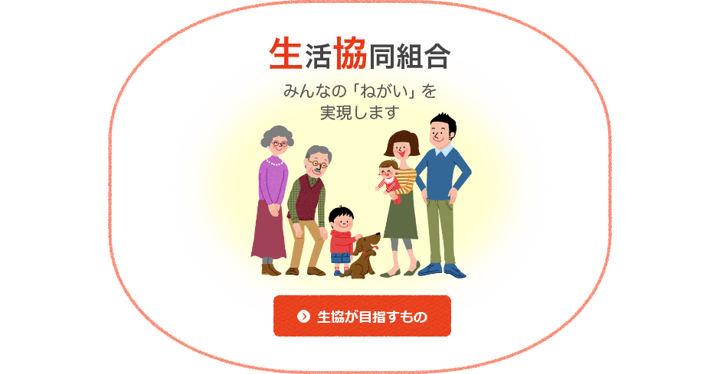
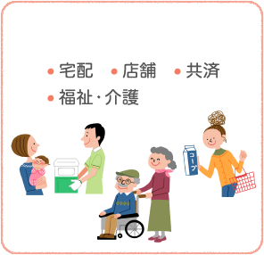
Outline of consumer Co-op in Japan
Pay the share together
(Become member)
Use the services together
Operate together
Consumer Co-op
・Home Delivery,
・Store, ・Insurance,
・Medical services,
・Welfare/Eldery care services
・Development and improvement of co-op services and products,
・Eventｓ and Seminars
Realize Everybody’s Wish
Notes:
The pictures show the basic principles that Japanese consumer co-ops follow.
Consumer co-ops are operated based on the trinity of sharecapital contribution, use of co-op business and participation in the operations and activities.
You have to pay share capital to become a co-op member. Consumer cooperatives Act prohibits co-ops to trade with non menbers, non members are not permitted to use consumer co-op services.
Most consumer co-ops place emphasis on member participation in the operation and activities.
Consumer co-ops in Japan are 100% owned by individual members and traditionally they have received no financial support or subsidies from governments.

Slide 4
Business of consumer co-ops
Grocery Retailing
Store
Home Delivery
including internet shopping
Insurance
Medical Services
Medical Services
Nursing-Care Services
Welfare Businesses
Child Care Services
Others
Notes:
Grocery retailing at co-op supermarkets and by home delivery channel, insurance, medical and welfare services are the main business of Japanese consumer co-ops.

Slide 5
No. of Consumer Co-ops and Membership
(thousand)
Membership is continuously increasing though number of co-ops sometimes decreases.
Notes:
For last seventy years, consumer co-op members have increased steadily.
In 2015, the number of consumer co-op members accounted for over a third of total households of Japan.
The number of primary consumer co-ops has been decreasing because of mergers of primary co-ops
and closing down of small co-ops.

Slide 6
Total Share Capital
(million)
Notes:
Total share capital is increasing according to the increase of members.
The average amount of sharecapital per member is JPY28000.
Some co-ops set the initial amount low and later encourage members to increase their investment.
The initial payment of sharecapital differs by primary co-ops. Usual amount ranges from JPY1000 (US$9) to JPY5000 (US$45).

Slide 7
Total Business Turnover
(million)
Notes:
The total turnover includes all the business of consumer co-ops i.e. grocer, insurance sales commission, medical and welfare services.

Slide 8
Structure of consumer co-ops
JCCU and its member co-ops operate their business independently of each other and do not constitute headquarters-branch relationship.
JCCU represents 568 societies including co-op business federations.
Japanese Consumers’ Co-operative Union (JCCU)
Business Federations of Community Based Co-ops
Prefectural Unions
National Unions of Categorical Co-ops
University / Health & Welfare / Insurance / Housing
Retail Co-ops |  |  |  | Service Co-ops
Community Based Co-ops | Institutional Co-ops | School Teachers’ Co-ops | University Co-ops | Health & Welfare Co-ops | Insurance Co-ops | Housing Co-ops
Primary Co-operatives
Notes:
This is the structure of consumer co-ops.
JCCU and its member co-ops operate their business independently of each other and do not constitute headquarters-branch relationship.
At present, JCCU represents 568 societies including co-op business federations.
Primary co-ops can be classified into two types.
Retail co-ops deal with grocery items and other daily necessities.
Community based co-op is the main part of consumer co-op in Japan. They have over 21million individual members out of 28million consumer co-op members.
They operate supermarkets, home delivery business and welfare services.
Most of community based co-ops form their own business federation with community co-ops of neighboring provinces to streamline their operations and gain bargaining power.
Institutional co-ops are co-ops that do business in workplaces i.e. offices and factories.
School teachers’ co-ops are a kind of institutional co-ops organized by teachers of elementary, secondary and high schools in the schools.
University co-ops are organized by college students and teaching staff of university.
Service co-ops are categorized by the services they provide.

Slide 9
Business of community based co-op
Welfare Business
Elderly care
service & facilities,
etc.
Member Activities
Mutual assistance,
Visiting producers
etc.
Retailing
Store operations
Home delivery
Insurance
Notes:
Typical community based co-op do grocery retailing and welfare business as well as member activities.
This presentation focuses on retailing and welfare business.

Slide 10
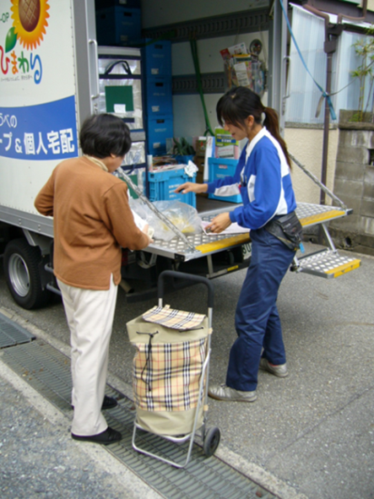
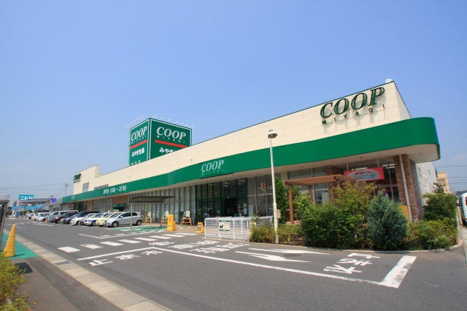
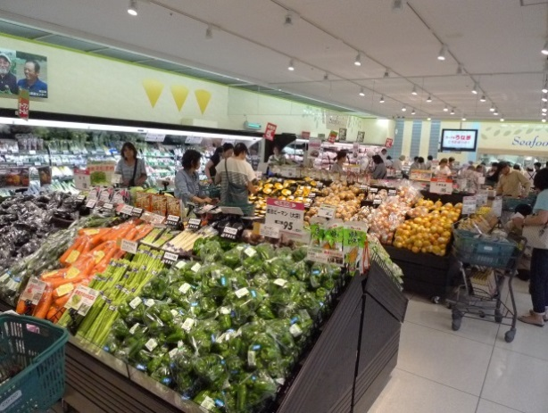
Community Based Co-ops
Home Delivery
No. of co-ops; 131
Owend by 21 million members
Turnover; JPY 2.7 Trilion (US22.5 billion )
Household subscription rate; 36.5%
Basic Law; Consumer Co-operative Act enacted 1951
Only Members can use Co-op Services
Store Operation
Notes:
This is the number of community based consumer co-ops as of FY2016.
As explained beforehand, consumer co-ops can do business only with members.
Therefore it is imperative for co-ops to gain many individual members to grow.

Slide 11
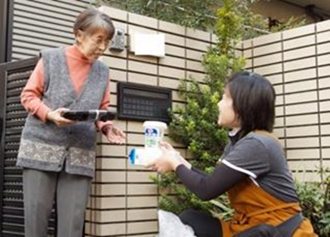
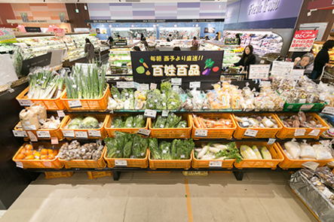
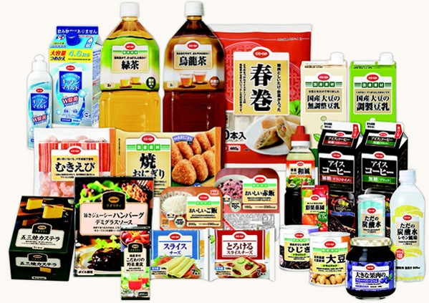
Community Based Retail Co-ops in Japan
Home Delivery Service
Sales : JPY1,638 billion (US$14.6 billion)
Store Operations
Sales :JPY 922 billion (US$8.2 billion)
No. of the Store : 896
Co-op Products (Collaboration between
JCCU and Member co-ops)
Over 4500 Items
Sales: JPY412 billion (US$3.7 billion)
Notes:
Consumer co-op as a whole has 5.4% of food market share in Japan. Consumer co-op is the third largest group in Japanese grocery market.
Homedelivery accounts for nearly 70% of the co-op grocery sales and this is the unique character of Japanese consumer co-op.business though some primary co-ops sell more at their supermarket than through homedelivery.
There are about 4500 CO-OP brand products which are developed by JCCU. CO-OP brand products share 15% of total sales of primary co-ops.
JCCU collaborate with its member co-ops/business federations of community based co-ops in the process of the product development.

Slide 12
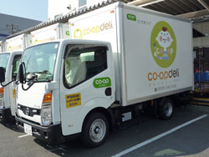
Home Delivery
2 Types of Delivery
groups / individuals
FY2015 Facts
Total delivery sales : 1,749 billion Yen
Delivery to individuals : 1,187 billion Yen
【See Youtube: CO-OP Home Delivery Service】
Notes:
There are over 15000 delivery vans used by primary co-ops nationwide.
The co-op vans visit members’ homes or the designated sites that members receive the delivery.
The delivery is once a week on fixed date and time. The average amount of monthly purchase per member is JPY11000(US$92)
There are four types of items delivered i.e. nonfood and food items under 3 temperature zones; room temperature, chilled under 10 degrees Celcius and frozen (minus 20 degrees Celcius).
Many co-ops hold exchange events between co-op staff and manufacturers of CO・OP brand products to raise staff’s knowledge and awareness about CO-OP brand products.

Slide 13
Home Delivery
For the people who have difficulty in cooking
Boxed meal delivery
Co-ops deliver not only fresh materials but also cooked meals and ready-to-cook meals to support members who have difficulty in cooking daily meals such as elderly people, physically challenged people.
Notes:
Meal delivery is a new home delivery service. Ready to eat meals are delivered five days a week.
In Japan, population is rapidly aging and people who have difficulty in household chores are increasing.
This service is popular among such members.
The meal delivery service is one of the solutions to such house chores problems.
As the delivery staff visit users everyday, it has an effect of watching over elderly people who lives alone.
Actually there are cases that delivery staff find fallen users and call ambulance for them.

Slide 14
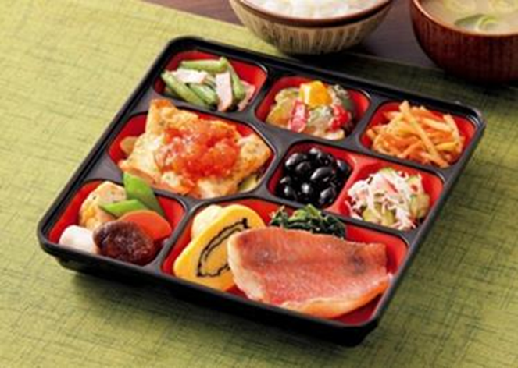
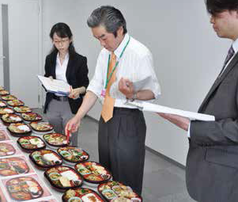
Home Delivery
Boxed meal Delivery
The meal delivery service is provided at 48 Co-ops in 44 prefectures with 125,000 meals daily. (2016)
Selecting the menus according to members’ voices

Slide 15
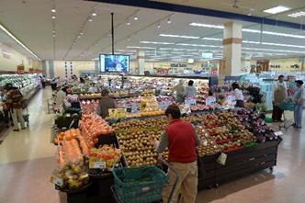
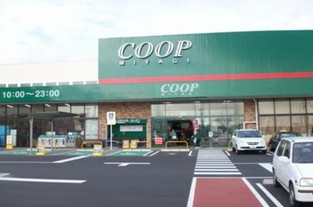
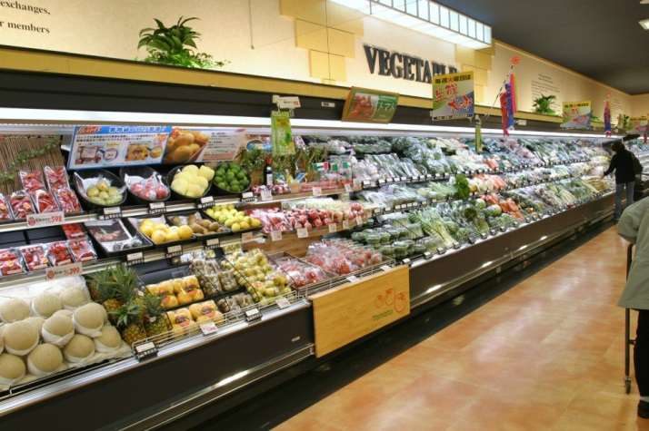
Store Operation - Outline
Various Type of Stores
supermarket, small supermarket, mobile store
FY2015 Facts
Sales : 903 billion Yen
No. of Stores : 920
Store Space : 1.31 million sqm
Notes:
There are about 900 co-op stores. Many of them are grocery supermarket.

Slide 16
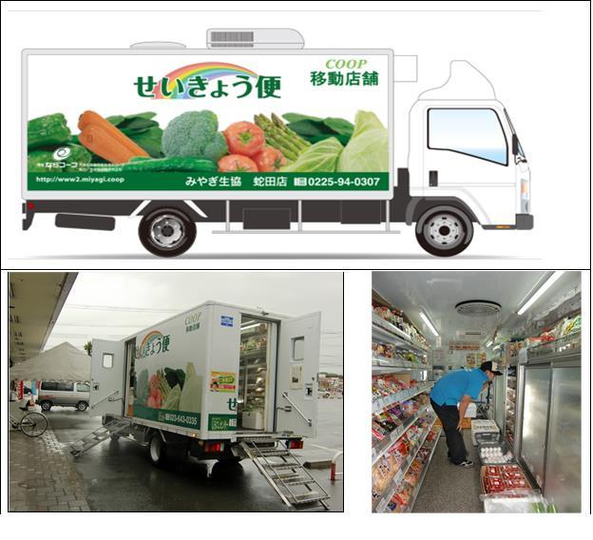
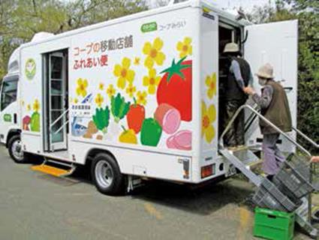
Store Operation
Sending mobile stores to the areas lacking in stores
155 vehicles
by 30 consumers’ co-operatives
(as of Jan. 2017)
Mobile Stores
Notes:
Co-op send ‘mobile stores’ to the areas lacking in shopping facilities to help members* shop daily necessities.
*e.g. elderly people, people living in food deserts.

Slide 17
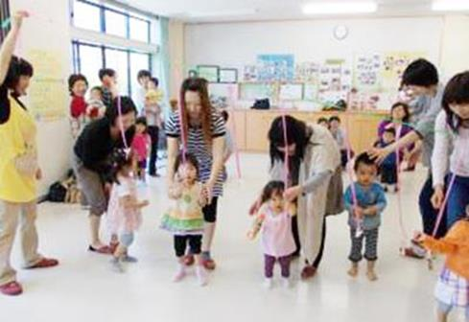
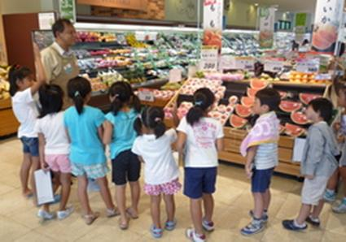
Store Operation
To Support community members
Members’ activities utilizing store facilities: study sessions, fun events, etc.
Store tours and fests hosted by store staff
Utilizing a meeting room for fun events
Store tour for school kids
Notes:
Each co-op store has a room and space for member activities.
Many co-ops offer fun events for mom and children, school pupils as well as study session for members.
Large scale co-ops have members hall and offer cultural programs.

Slide 18
Co-op Insurance
Consumer co-ops offer life and general insurance products that suit the needs of member consumers with reasonable premiums and better coverage.
There are 2 insurance federations that are affiliated to JCCU.
Japan CO-OP Insurance Consumers' Co-operative Federation (JCIF) is the insurance wing of JCCU. The policy holders are primary consumer co-op members. There are over 8.5 millon policy holders.
National Federation of Workers and Consumers Insurance Co-operatives (ZENROSAI). Its main policy holders are trade union members.
There are 31million policy holders.
Notes:
The members and policy holders of ZENROSAI are trade union members and they are not necessarily the member of primary consumer co-ops that are affiliated with JCCU.

Slide 19
Welfare Businesses
According to the current status of ageing population
in Japan, many consumer co-ops are providing various welfare services to meet members’ needs.
Day care center
Home care service
Meal delivery service
Housing service for senior members
Group home for senior members
FY2015 sales : 19.3 billion Yen by 43 Co-ops

Slide 20
History of consumer co-op movement in Japan
Birth and Expansion
First Consumer Cooperatives established (Kyoritsu-Shosha
and Doeki-Sha in Tokyo, Osaka Kyoritsu Shoten in Osaka,
followed by Kyoritsu Shoten in Kobe the following year)
1898 Consumer cooperatives Kyodo-Ten [Cooperative Store]
established in about 15 cities
Industrial Cooperatives Act enacted in response to new
social problems
⇒ Consumer Co-ops defined as “Urban District Purchase
Associations” according to the act.

Slide 21
Movement before the Asia-Pacific War
1919-1931
Retailing cooperatives for workers (Kyodo-Sha in Tokyo and Kyoeki-Sha in Osaka etc.), retailing co-ops of citizens (Family Purchase Association in Tokyo, Kobe Consumer Cooperative, Nada Purchase Association etc.), cooperatives in universities and schools, and medical cooperatives established.
1930’s-1945
Co-operative movements suppressed and hampered during militaristic period.
Notes:
In Early 20th century, consumer co-ops were established in many cities. Their main purpose was to jointly purchase daily necessities at reasonable price.
Co-op movements of this era were led by workers

Slide 22
Student co-op movement; promoter of consumer co-op movements photo; circa 1926

Slide 23
One of the oldest consumer co-ops in Tokyo photo; circa 1928

Slide 24
Expansion of Business Areas in the Recovering Economy
1945- Worker welfare activities, laborer community co-ops
and consumer co-ops spreaded business fields
6503 primary consumer co-ops /2.97million members
1948 Consumer Cooperatives Act enacted
1950’s Small co-ops mushroomed and collapsed
1951 Japanese Consumers’ Co-operative Union established
1960’s Incorporation and development of “citizen cooperatives”
nationwide
1970 2.89million members

Slide 25
In 1947, there were 6503 primary consumer co-ops.

Slide 26
Consumer Coopeatives Act enacted in 1948. Co-op leaders advertised co-op by campaign wagon.

Slide 27
Wide-spreading “joint purchase” centering on housewives
1970’s Development of Joint purchase (group delivery) business
in urban areas
1980’s Up-rise of Anti-Cooperative campaigns by SMEs
1985 10.2million members
1990’s Management crises of some co-ops
Development of co-op insurance business
Formation of regional business federations
-2000’s Structural reform of primary co-ops
Rapid growth of home delivery service to individuals

Slide 28
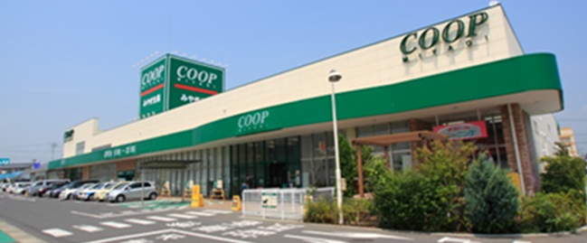
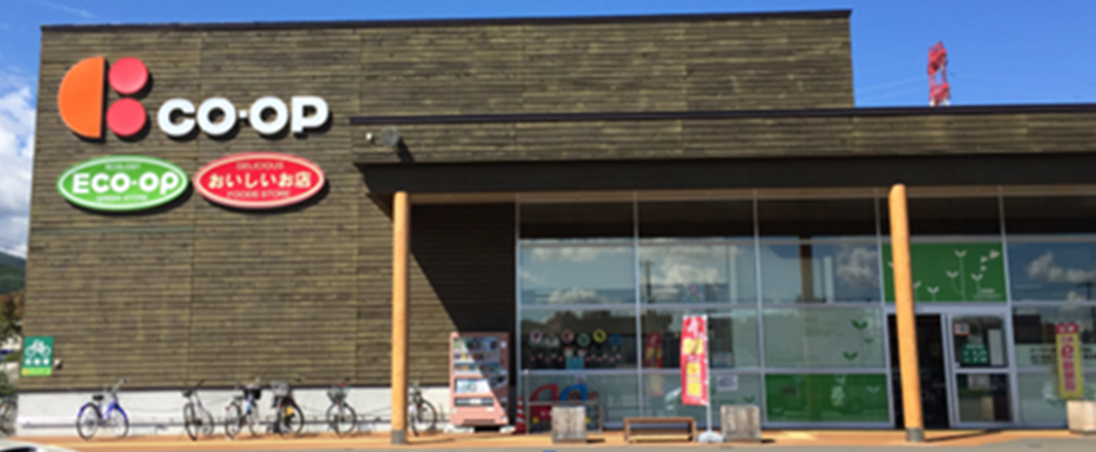
Visit JCCU website
http://jccu.coop/

